Slide 1

TEAM – 6 Presentation
Club Activities Project

Slide 2
Team members:
WEB- APP
CH. SAITEJA
V. LAHARI
E. ANUSHA
DATABASE AND API
P. VISHNU VARDHAN REDDY
ANDROID – APP
VINEETH SHARMA
L. MANOJ
MENTOR
HAANY ALI

Slide 3
The Problem Statement
A smartphone app to allow students to check their enrolled clubs and activities that they have taken part in.
The app should also facilitate student login, session tracking and having details of the student.
A web app that serves as admin and super-admin access point.
Super-admin should be able to assign admins to clubs. And dismiss them too.
Admins will deal with day-to-day club activities such as adding members, removing members, adding activities and events for the club members.
Both the mobile app and web app share the same Database so that consistency is achieved.

Slide 4
Technology Stack
Web-App
HTML, CSS
JavaScript
Django Framework
JWT ( for Tokens and Session Handling )
Android-App
Java/ Kotlin
Database/API
MySQL with a RESTful API

Slide 5
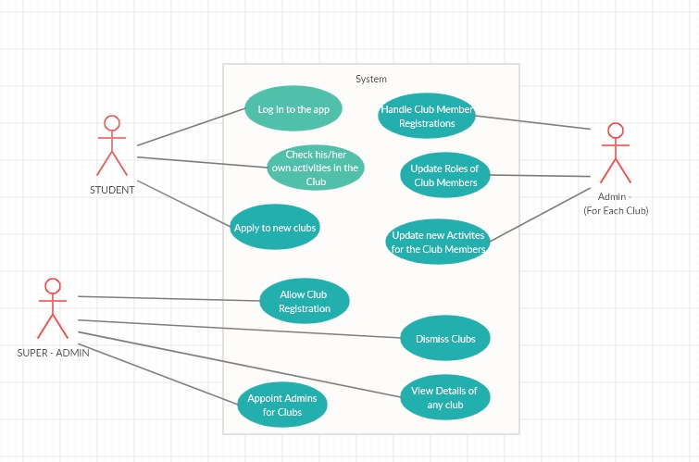
UML DIAGRAM

Slide 6
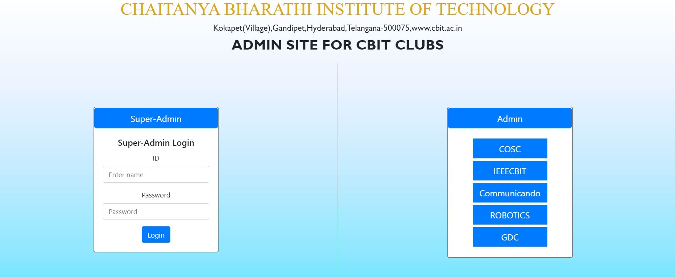
Web app:

Slide 7
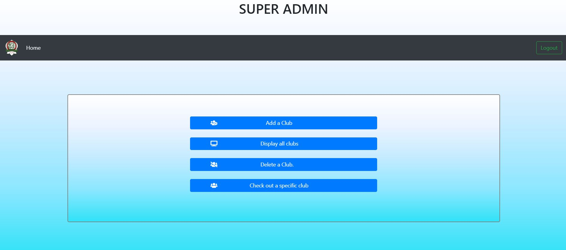
Super Admin Functionalities:

Slide 8
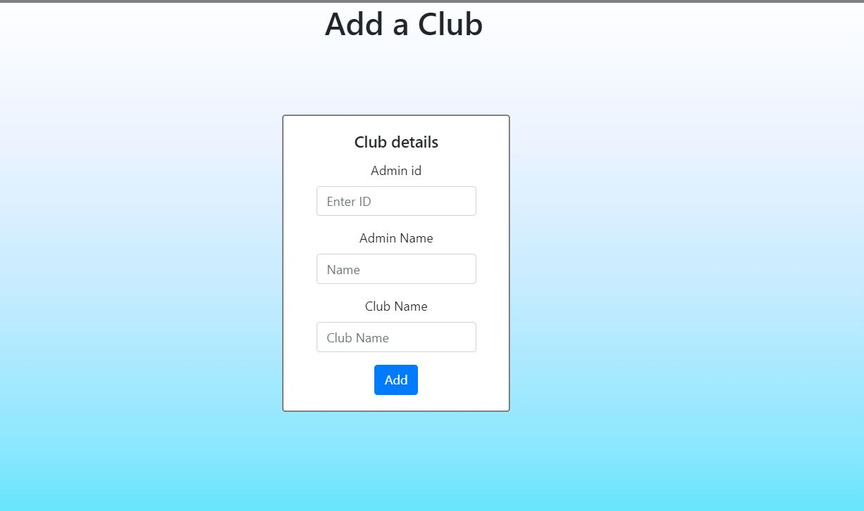
Add Admin Page:

Slide 9
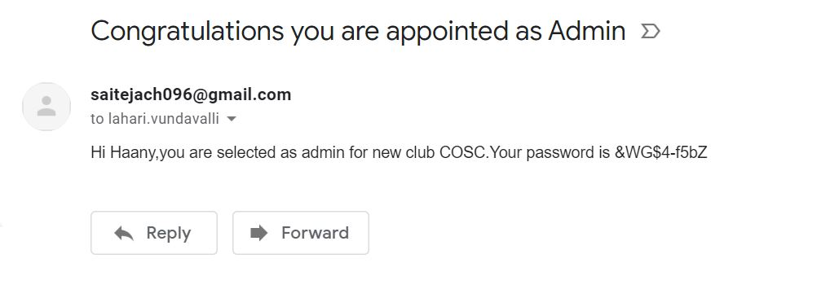
Notification to Admin:

Slide 10
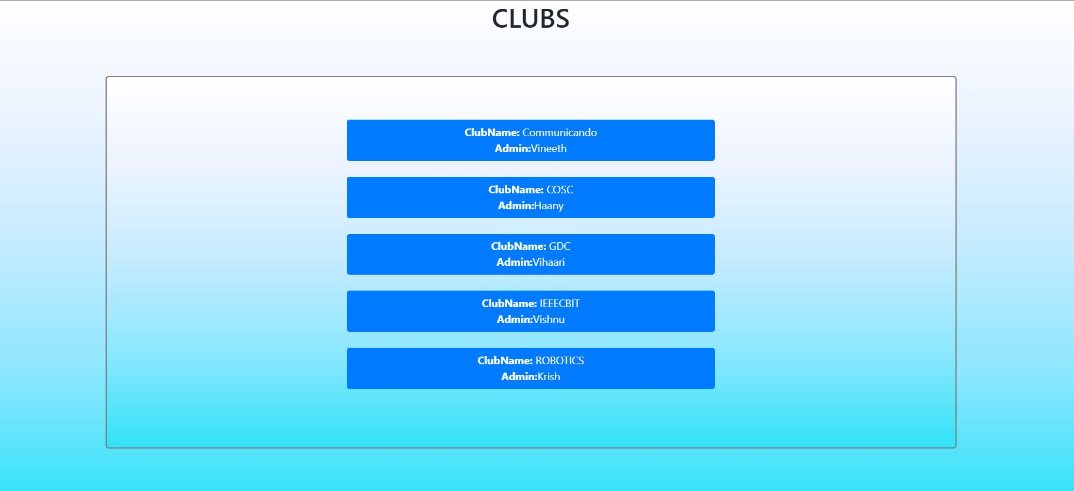
View Admin Page:

Slide 11
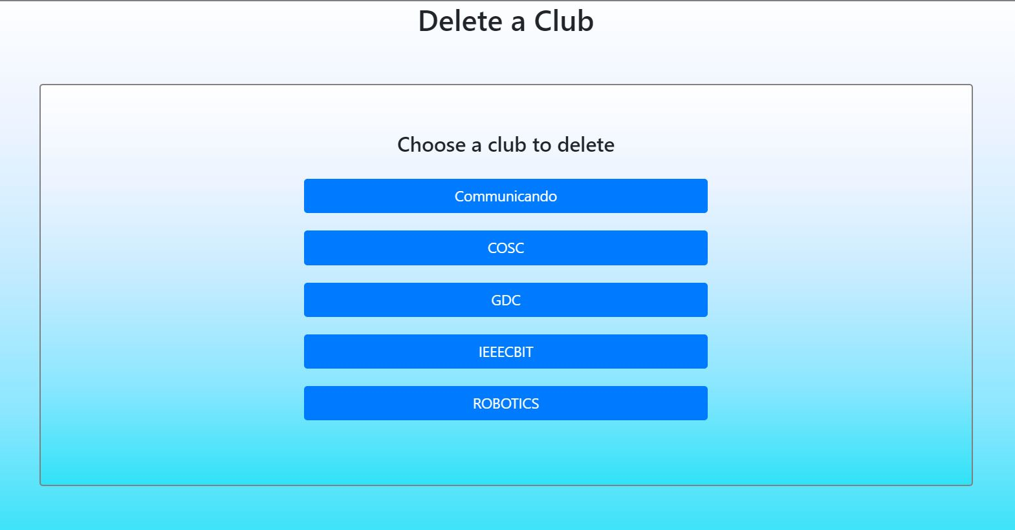
Delete Club Page:

Slide 12
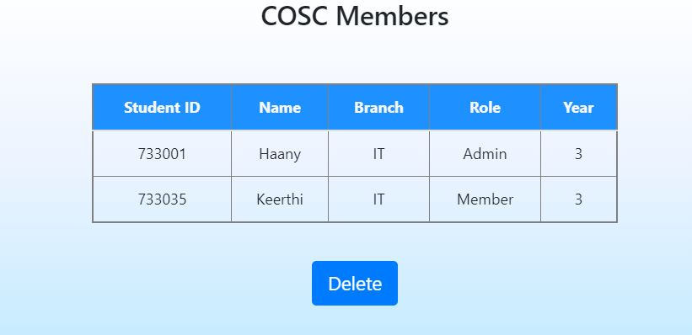

Delete Club Page:

Slide 13
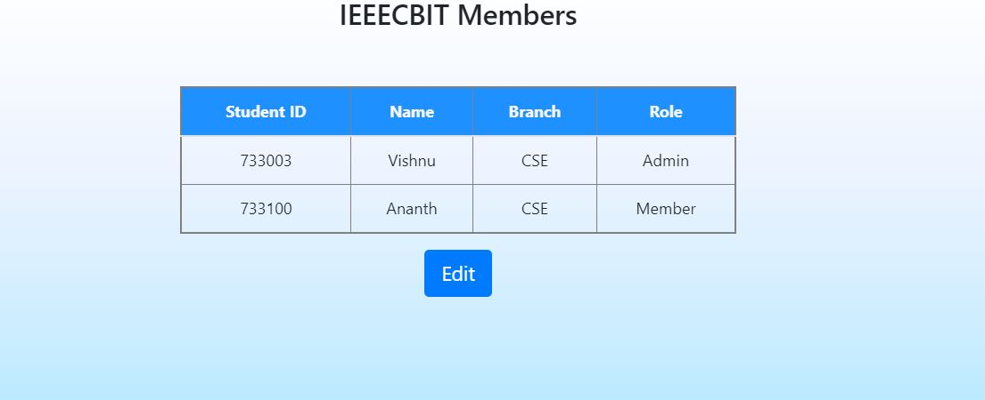
Edit Admin Page:

Slide 14
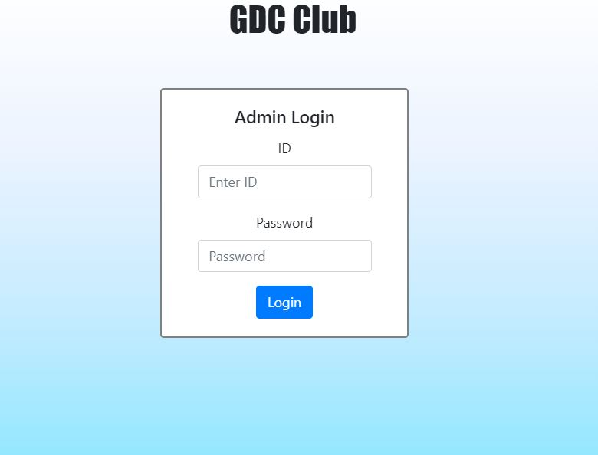
Admin Login:

Slide 15
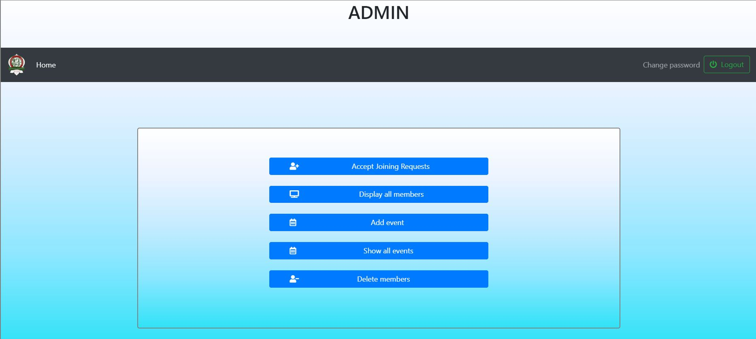
Admin Functionalities:

Slide 16
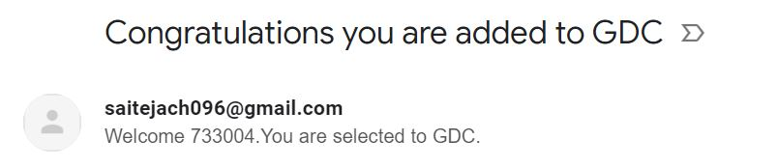
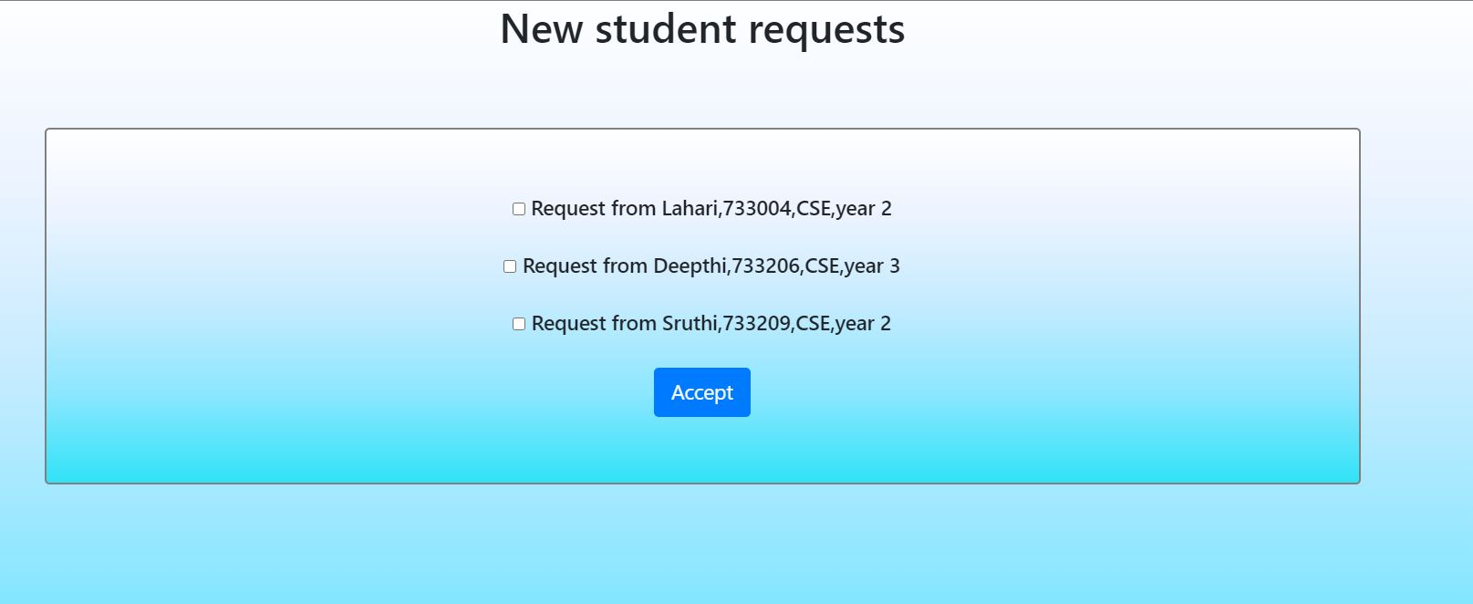
Accepting Requests to the Club:

Slide 17
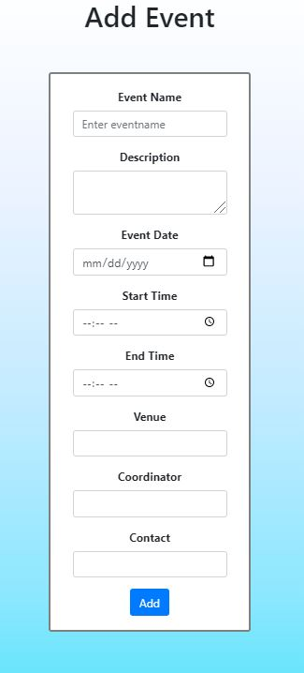
Add an Event Page:

Slide 18
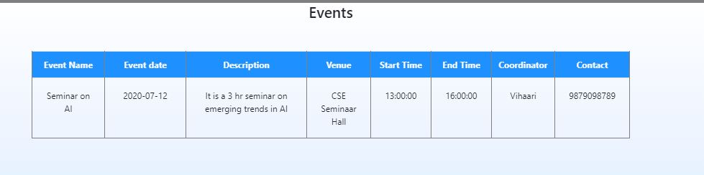
Display Events Page:

Slide 19
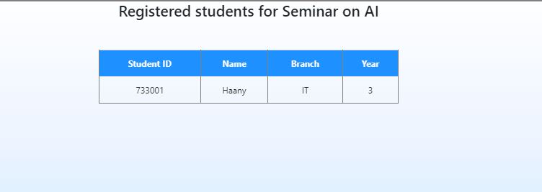
Display Participants of an Event:

Slide 20
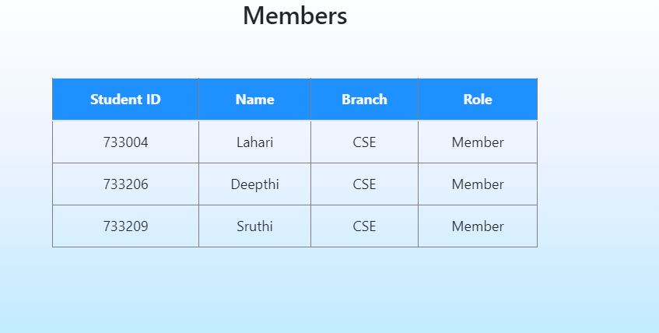
Display Club Members:

Slide 21
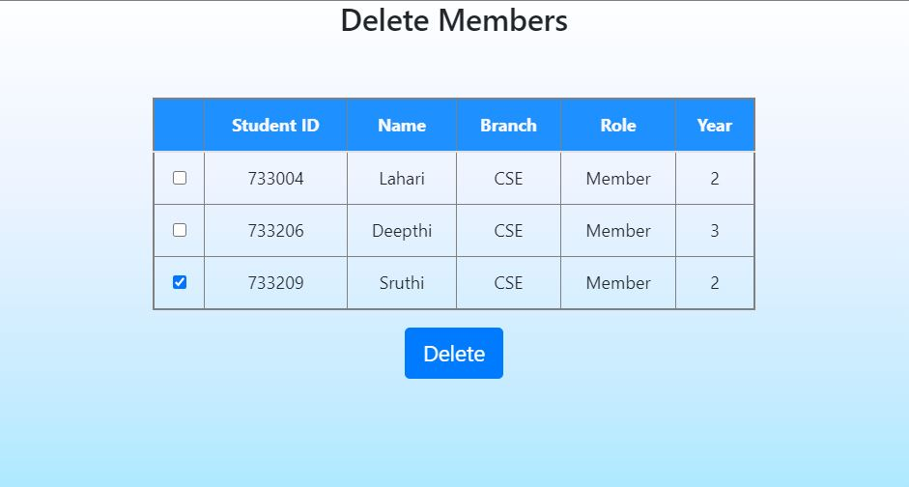
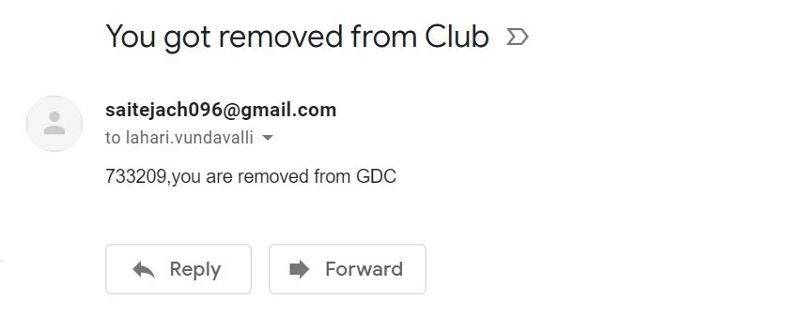
Delete Club Members:

Slide 22
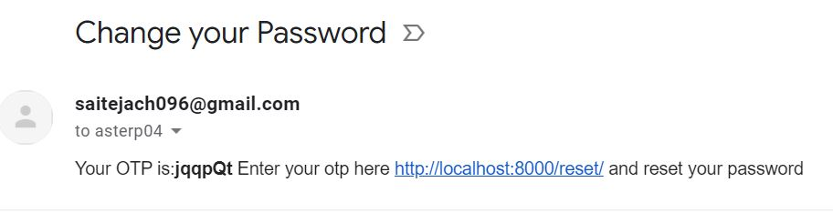
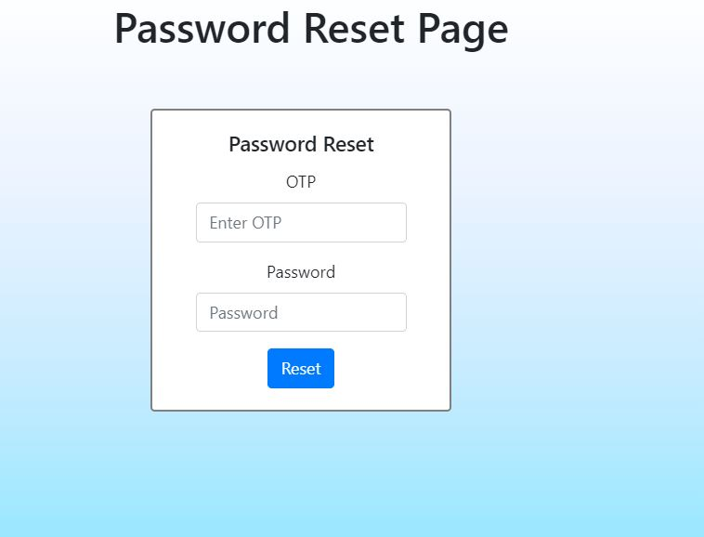
Reset Password:

Slide 23
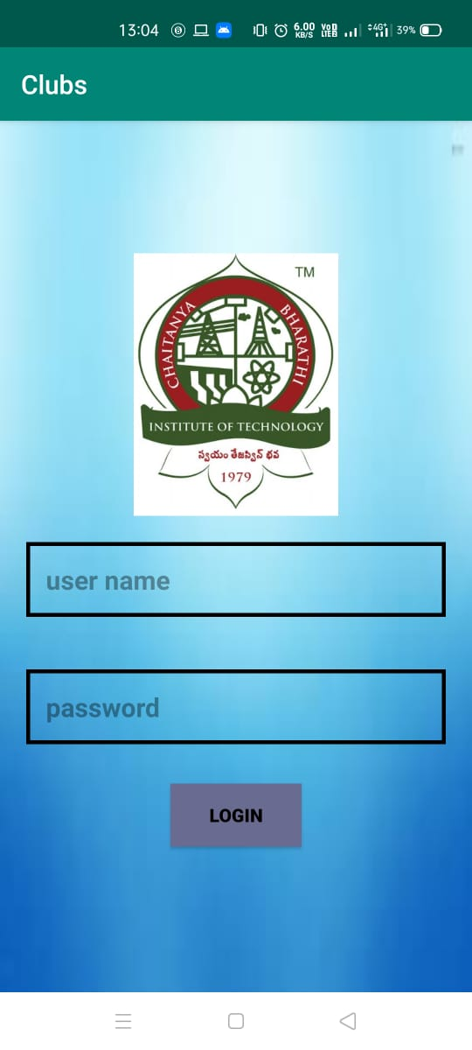
Android app:
Login page:

Slide 24
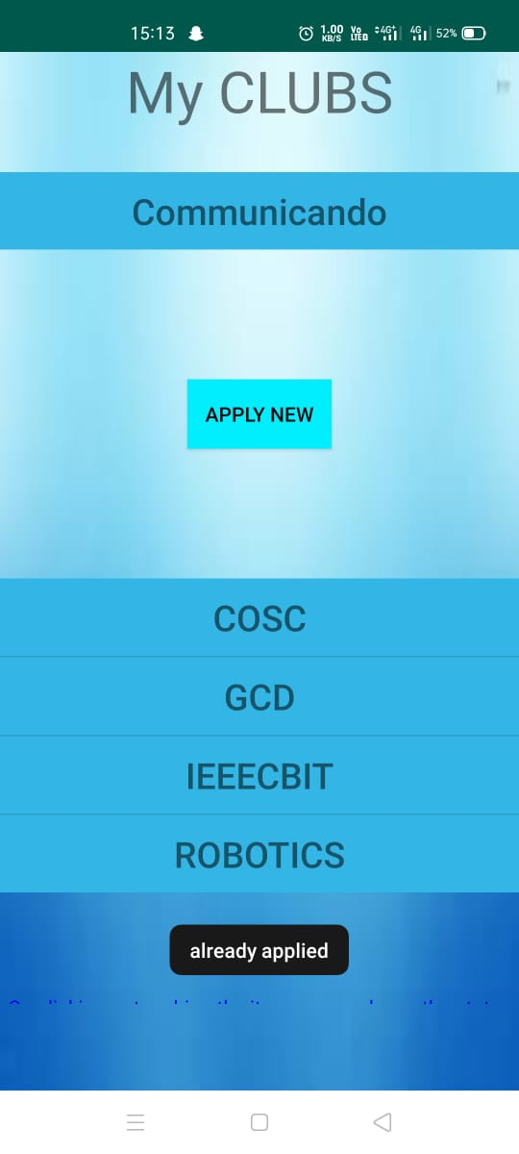
Student Clubs Page
This will show all the club student is in and all the activities they have been a part of.

Slide 25
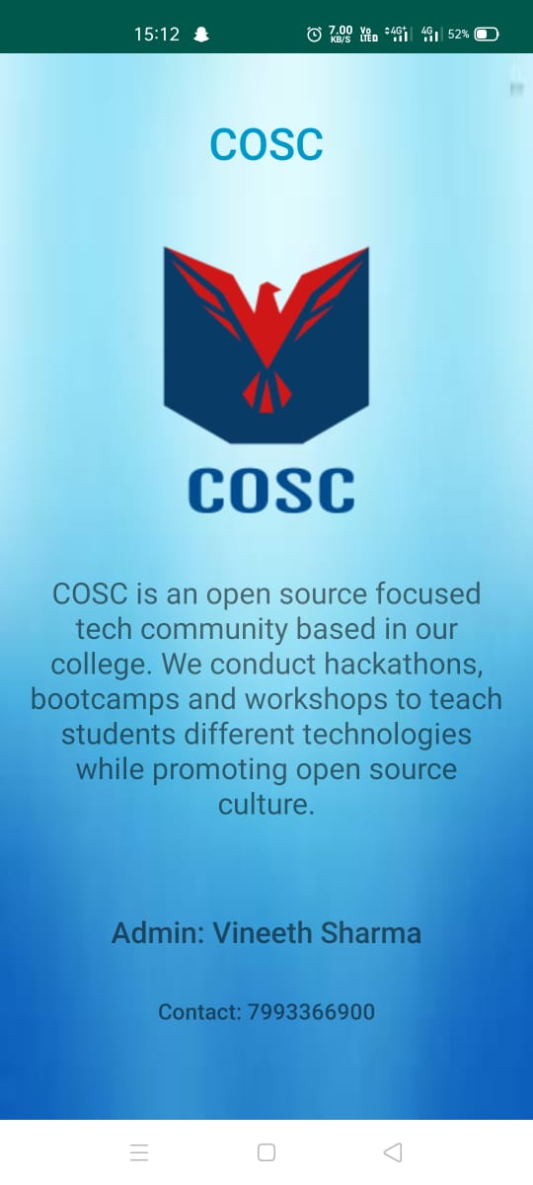
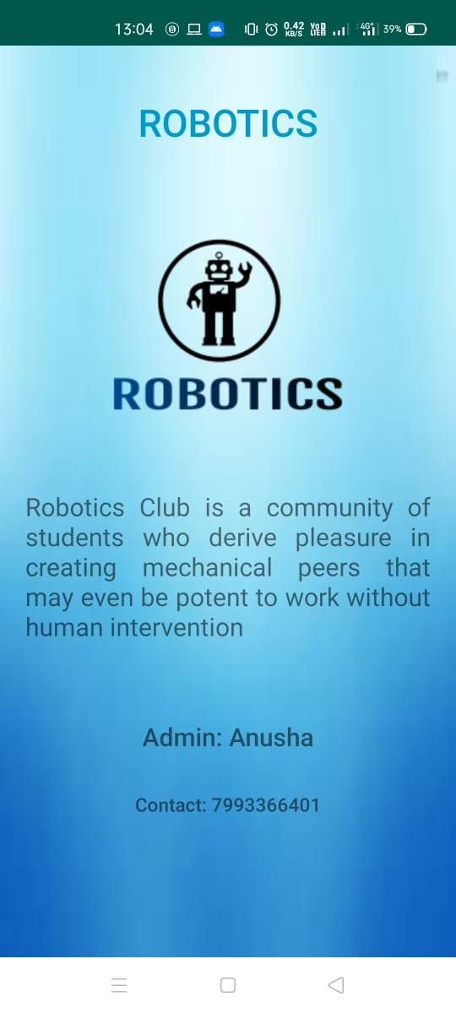
Club Description Page

Slide 26
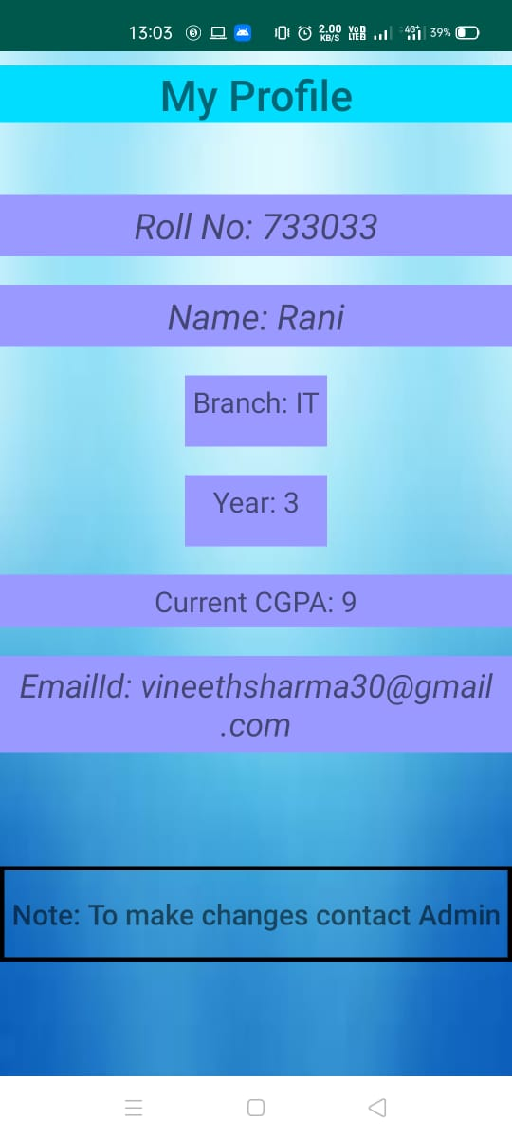
Student Profile Display
As the student adds more of their details into the app, more of them get displayed here. Things such as their year of study, grade, hobbies, etc.

Slide 27
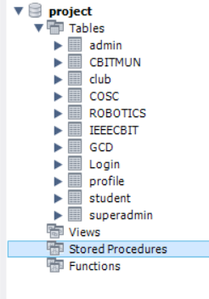
Database
Database is written in MySQL
It is held in an Amazon RDS Instance server.
The API for the app is written in Flask-RESTful API format
The API is hosted on Heroku . API deployed link http://clubprojectteam6.herokuapp.com

Slide 28
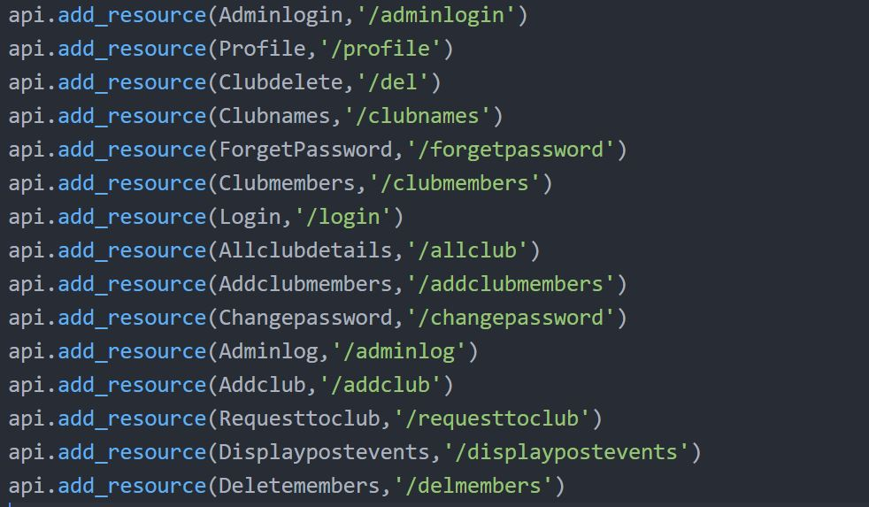
API

Slide 29
Thank You

